Slide 1

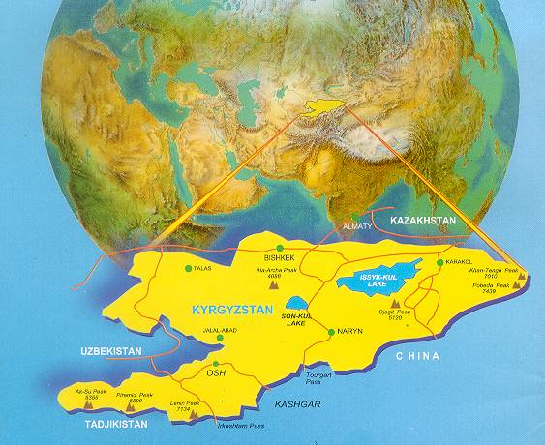

Preliminary Results of the
Strengthening Health Systems to Reduce Lead Exposure Project in Kyrgyzstan

Slide 2
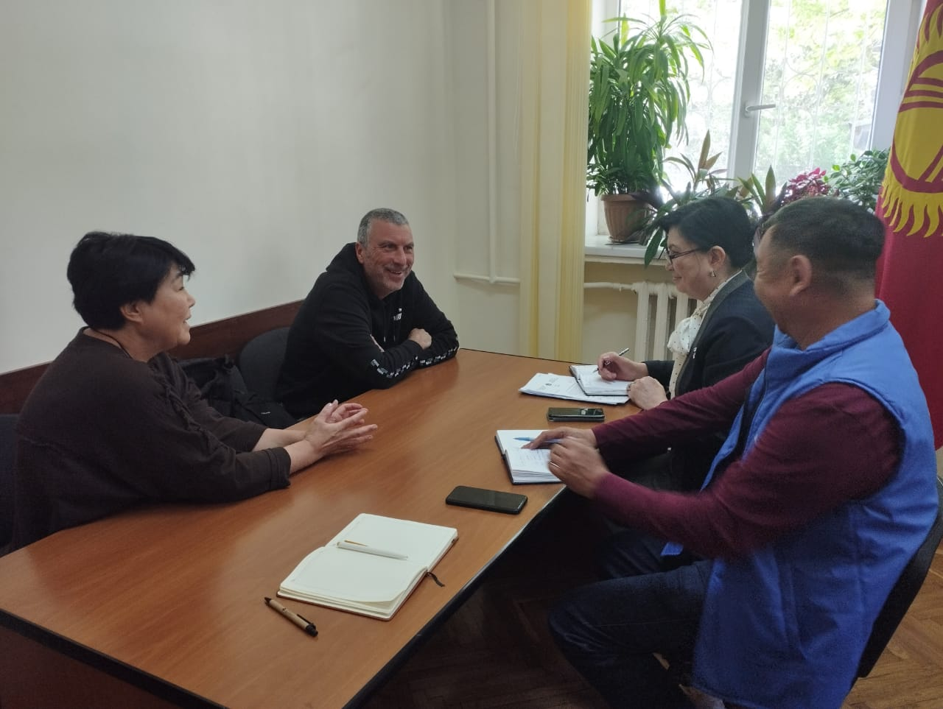
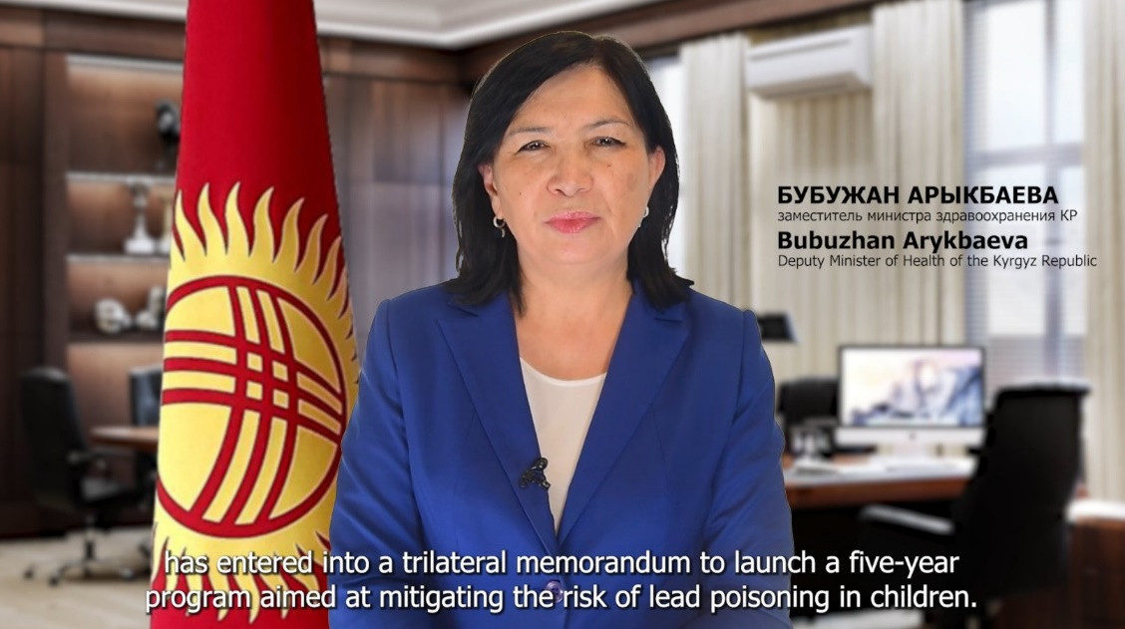
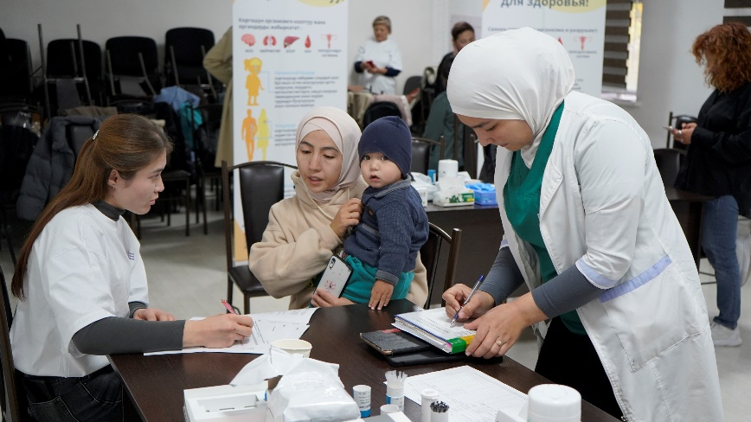
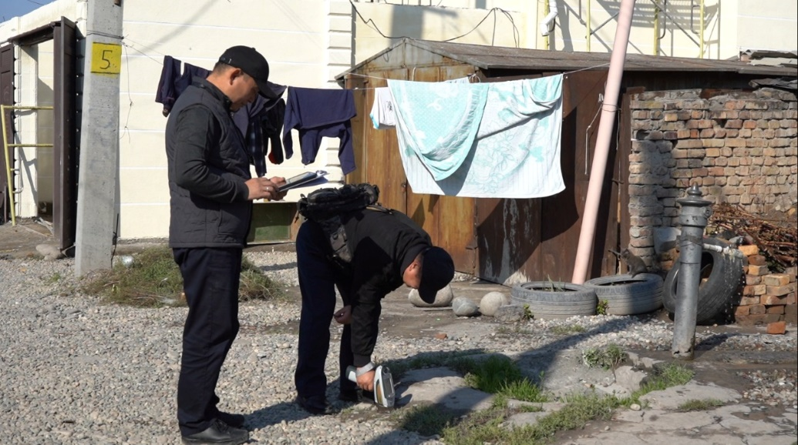
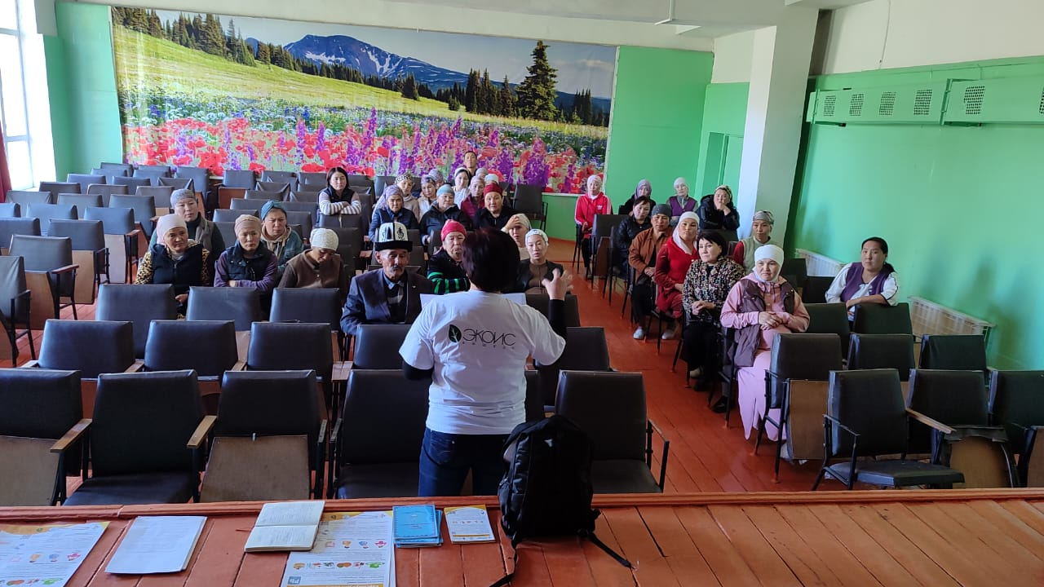
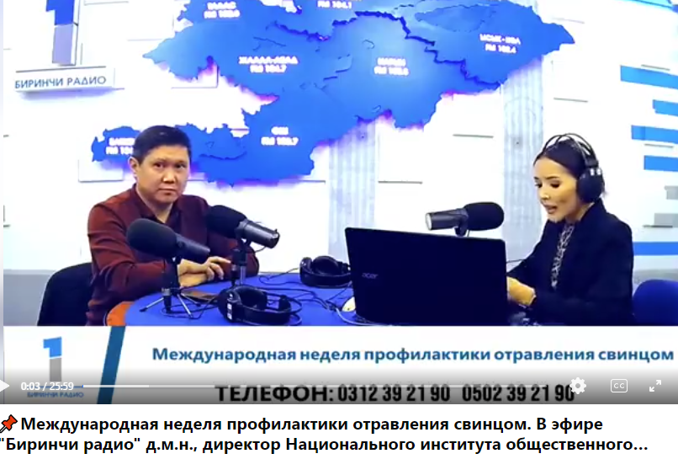
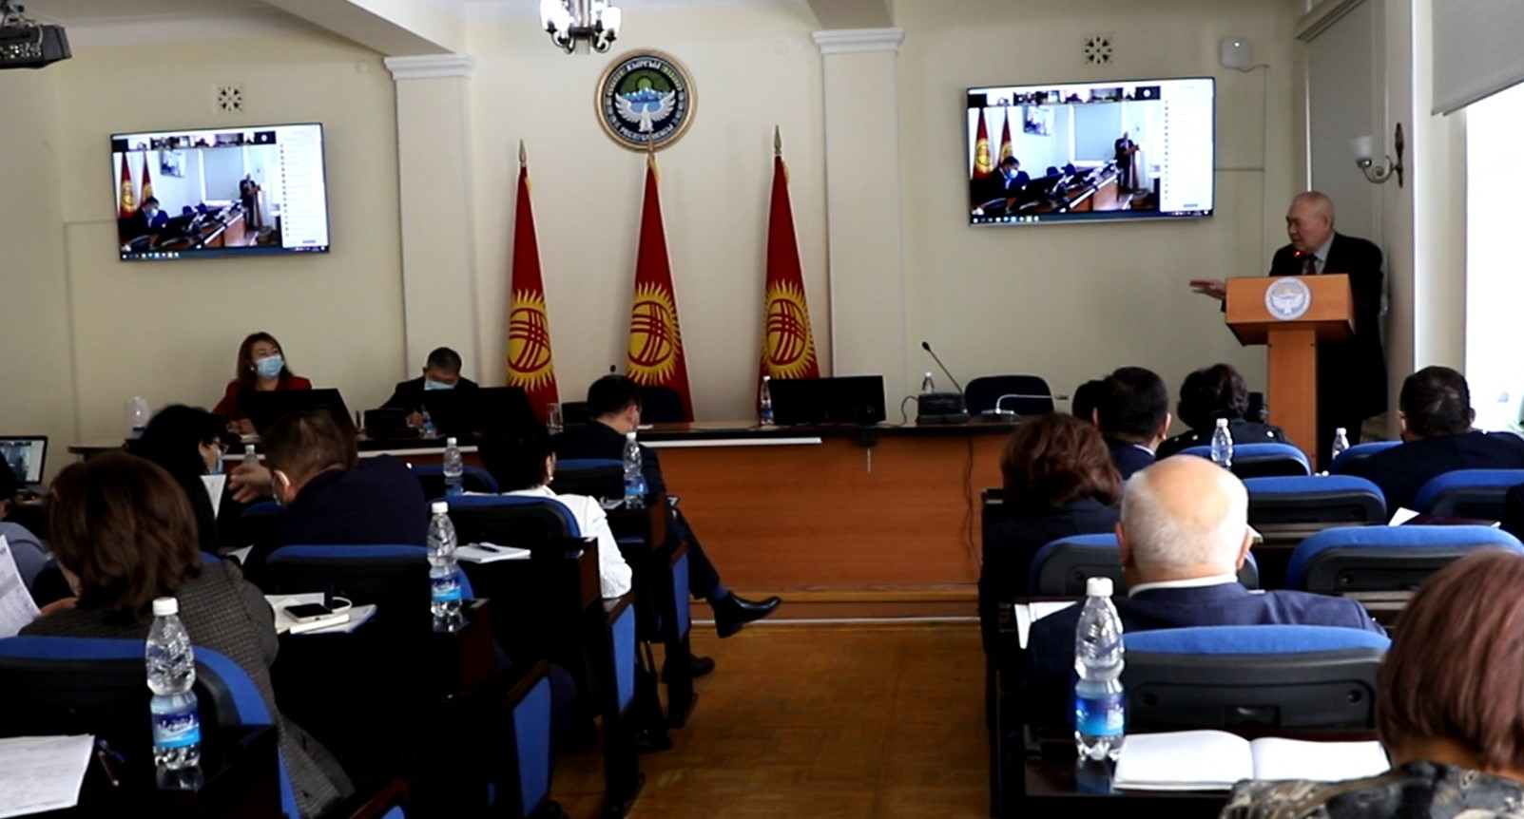
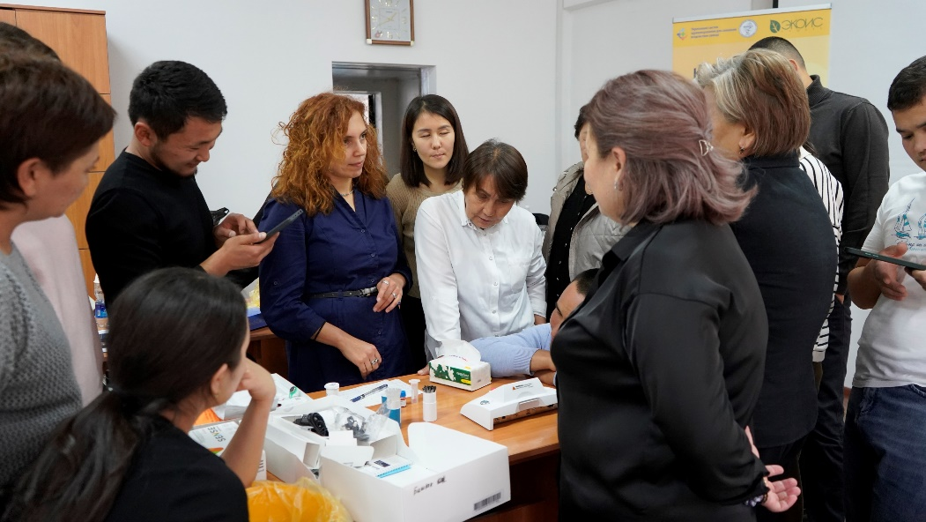
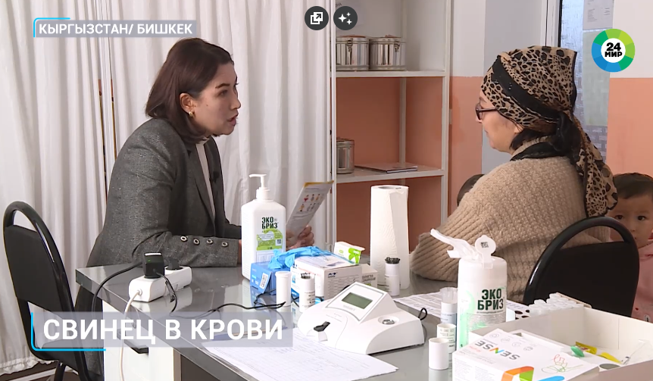
Project Results (2023–2025)
2023
2024
2025
Jan – Apr
Jul
Dec
Jan - Sep
Oct - Mar
Mar - Sep
Oct
Inter-Ministerial Working Group
Established
Capacity of nat'l labs
assessed
Equipment importing
LeadCare
XRF
Trainings
BLL
HBA
Environmental sample analysis
Public Awareness
MOU
International Lead Poisoning Prevention Week
Press-conference
Webinar
Round Table
BLL, HBA finalizing, data analyses
Project Coordinator appointed: Deputy Minister Dr. Bubuzhan Arykbaeva
ICP-MS
technical specification
provider contracting
Study protocol developed

Slide 3
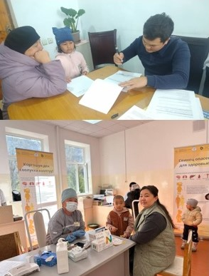
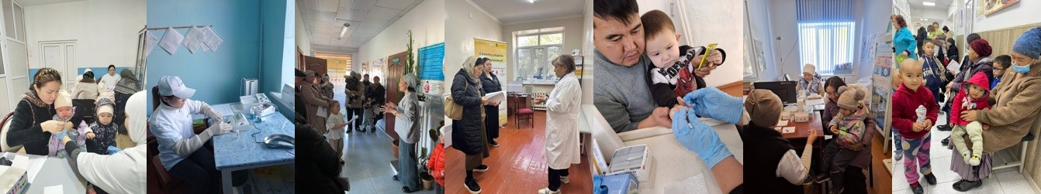
Research and Monitoring Activities
A study protocol was developed with support from Vital Strategies and approved by the Ethics Committee
1,140 children were tested for lead levels
188 households were assessed for lead contamination
44 children had venous blood samples taken in cases where LeadCare II results exceeded normal levels.
114 soil and drinking water samples were analyzed

Slide 4
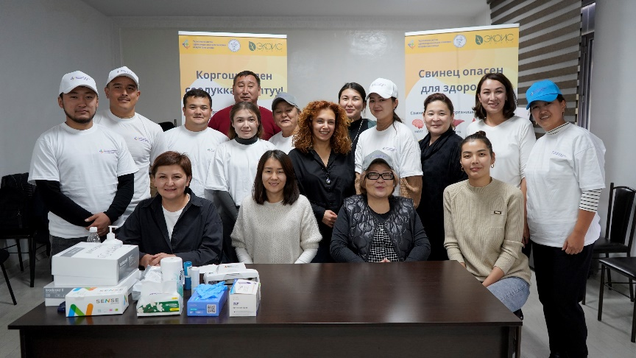
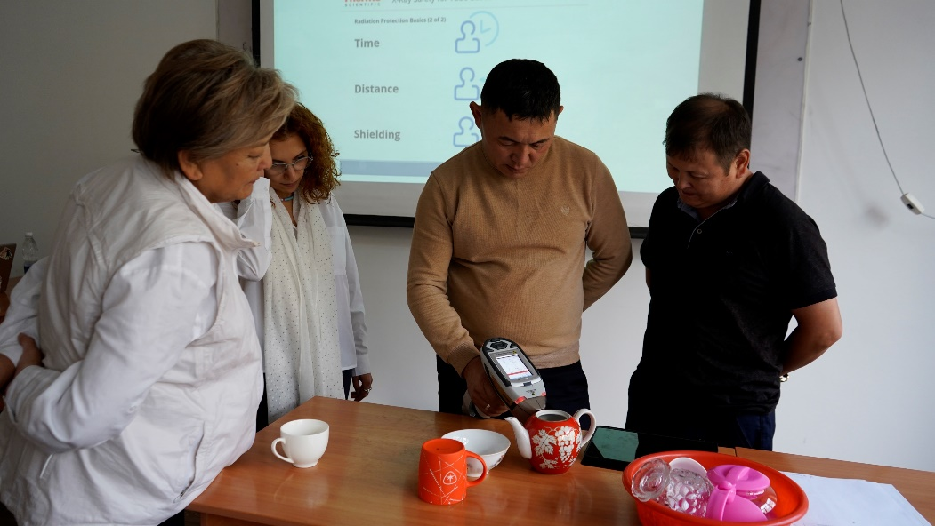
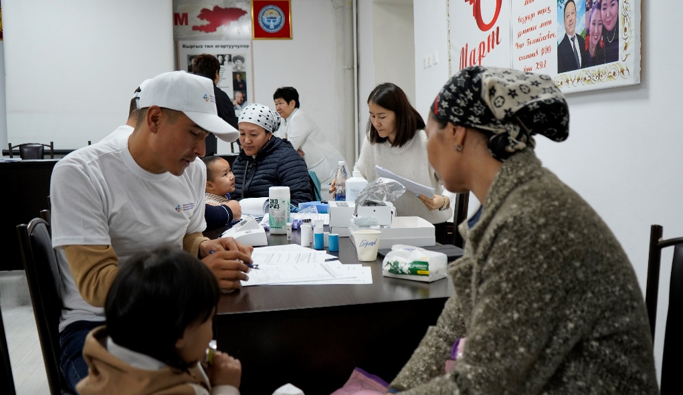
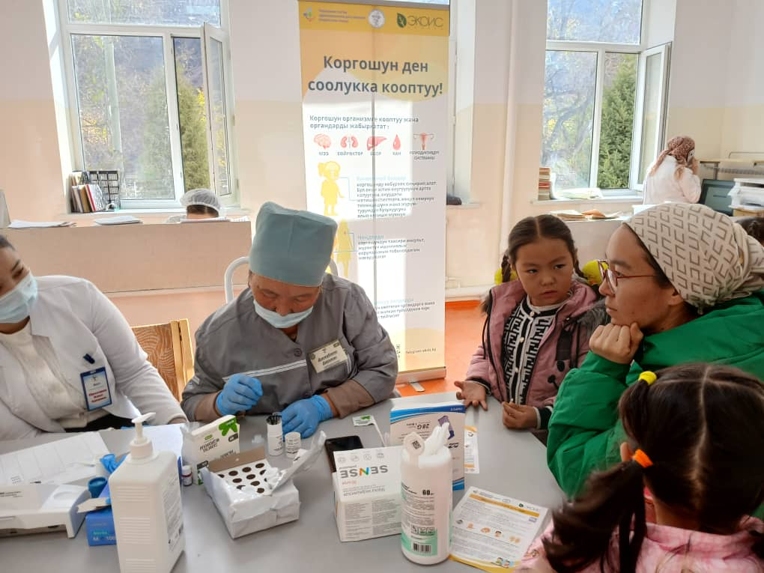
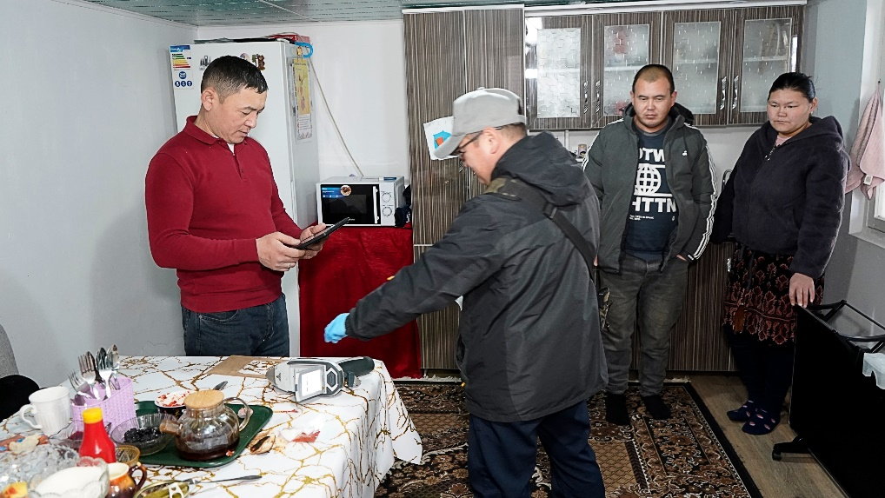
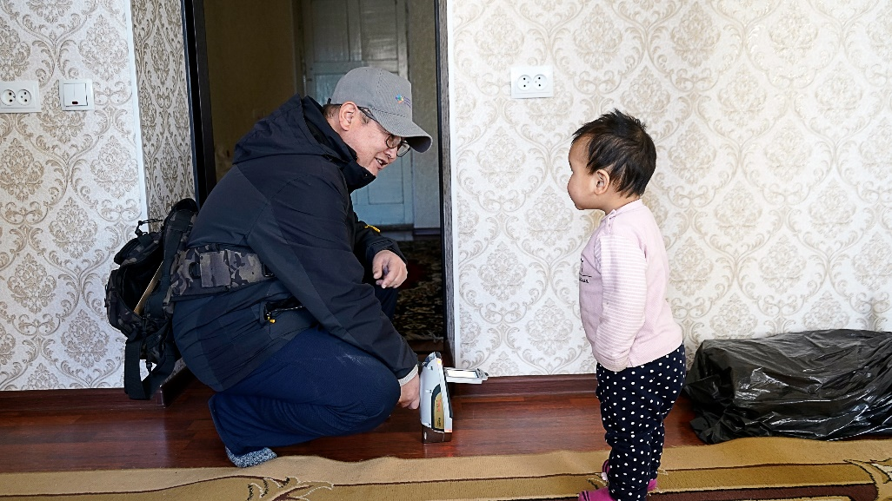
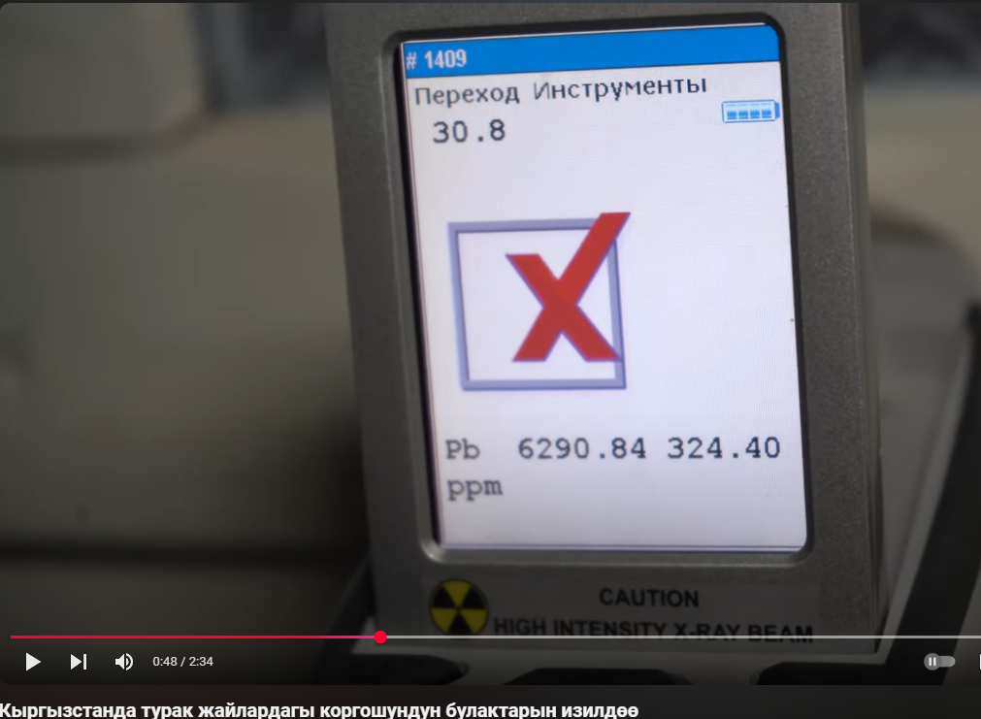
Training of Six Research Teams on
Blood Lead Level (BLL) Testing and
Home Based Assessment Data Collection

Slide 5
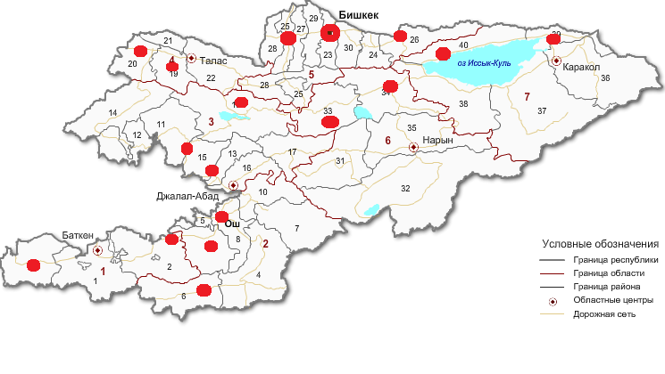
Research conducted in 21 settlements
18 areas with no known source of lead exposure
3 areas know to have legacy lead sites

Slide 6
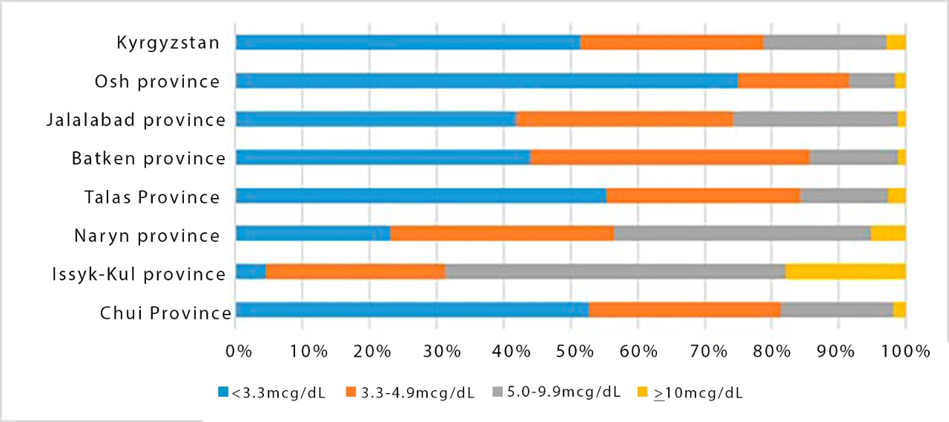
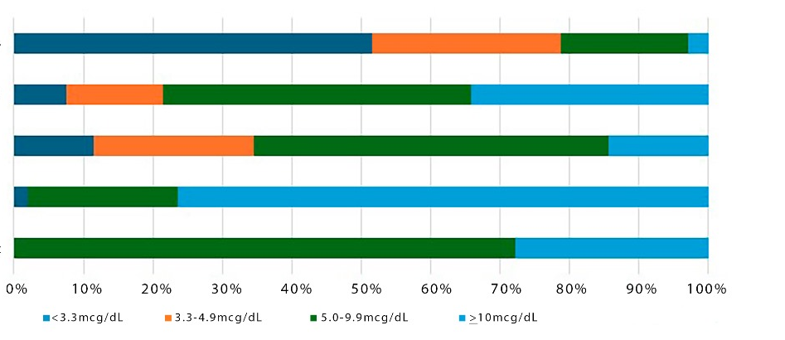
Distribution of Capillary Blood Lead Levels in Children Across Kyrgyzstan
Study shows lead poisoning in children in Kyrgyzstan is pervasive and requires a national monitoring and prevention program.
Distribution of Capillary Blood Lead Levels in Children Residing in Ecologically Polluted Areas of Kyrgyzstan
Regions with No Known Sources of Lead Exposure
Legacy Contaminated Regions
Mailuusuu (legacy mining site)
Sovetskiy (legacy mining site)
Ak-Tuz (legacy mining site)

Slide 7
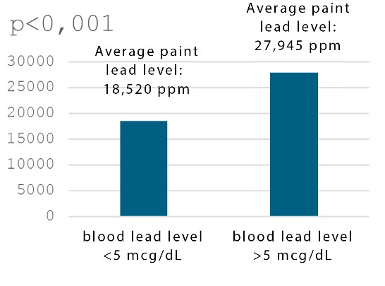
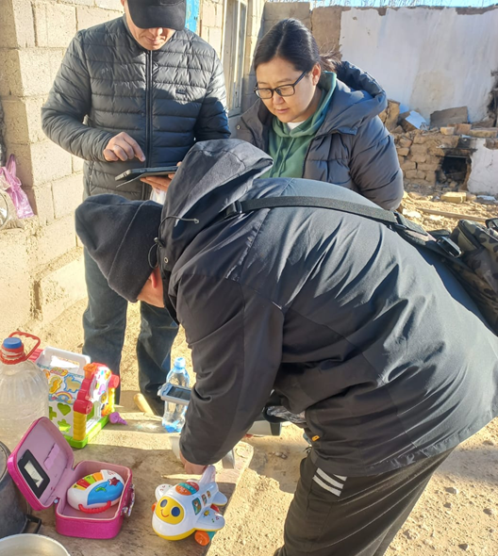
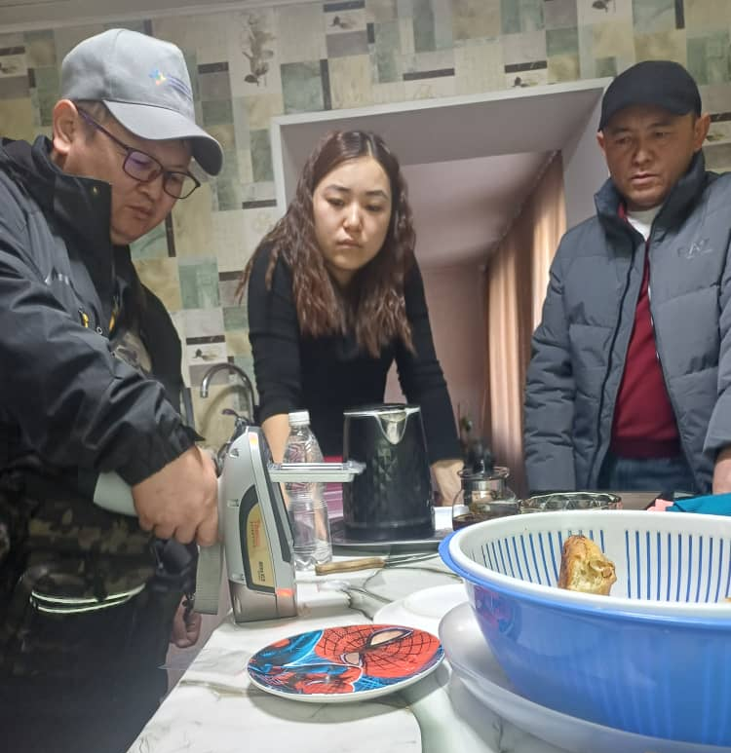
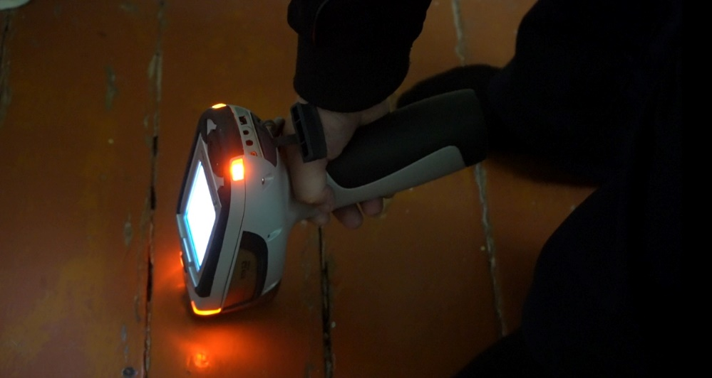

Paint is a Key Source of Exposure
First round of home based assessments (HBAs) found that paint is an important source of lead exposure in Kyrgyzstan.
*HBAs were not conducted in legacy mining sites.

Slide 8
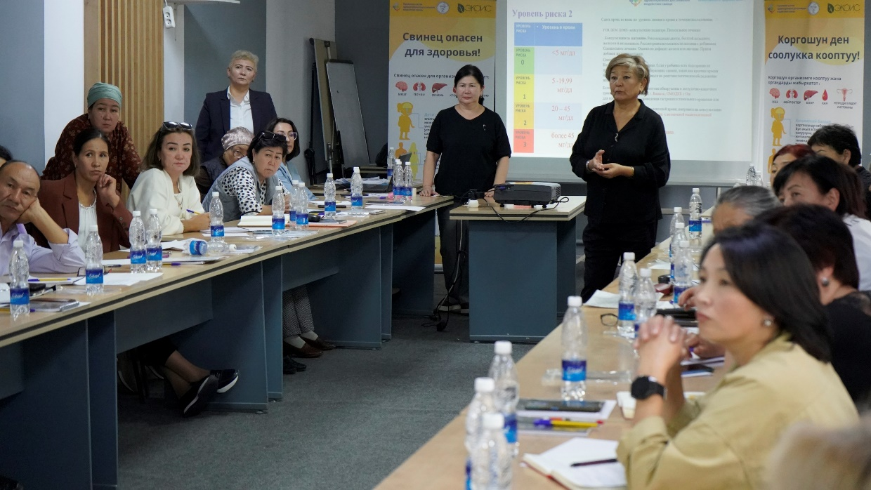
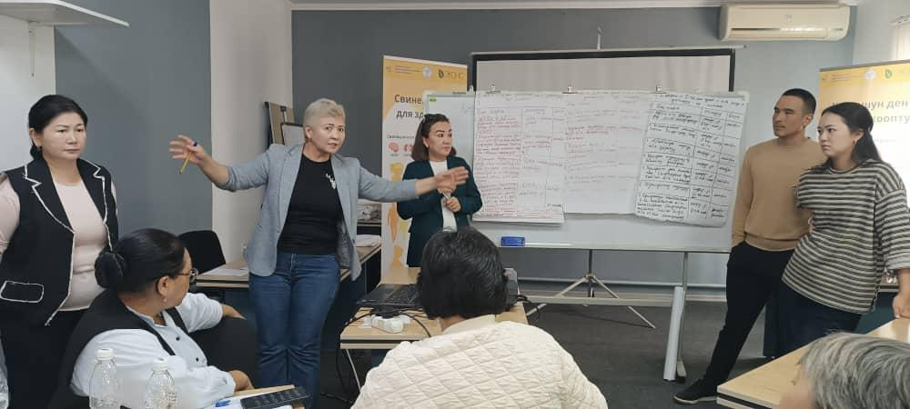
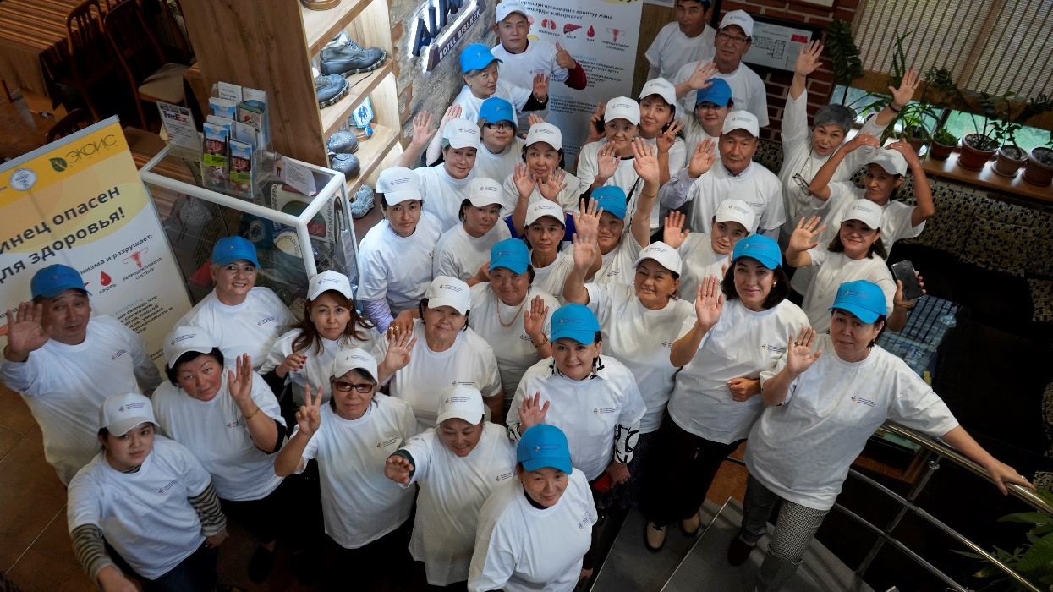
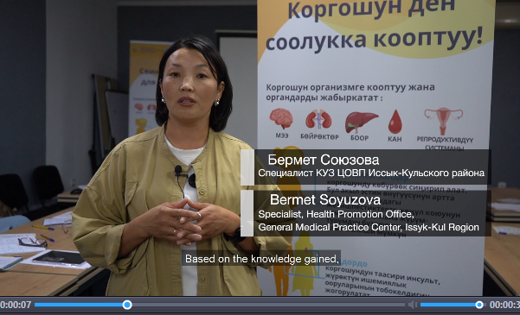
Public Awareness and Outreach
Training of Trainers for 45 specialists from the Health Promotion Committee and National Public Health Institute
Development of informational and educational materials, public awareness videos
A broad information campaign in collaboration with the Republican Center for Health Promotion

Slide 9
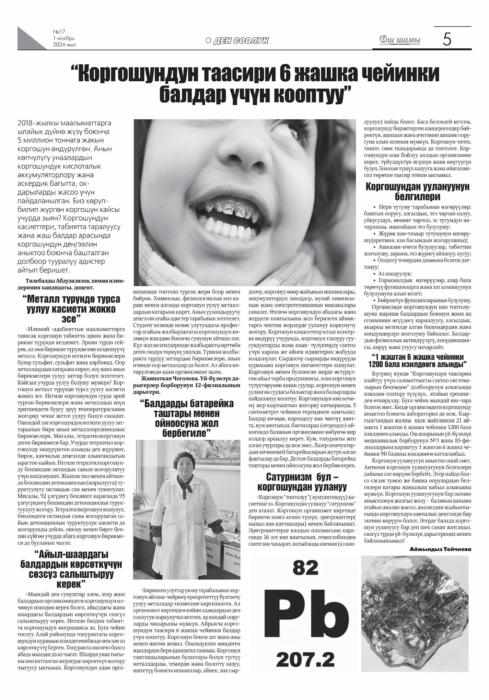
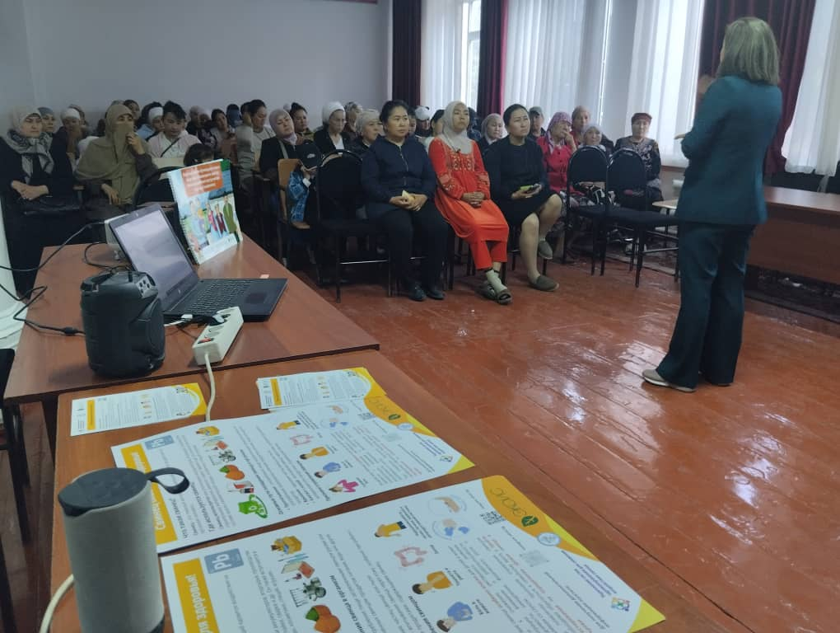
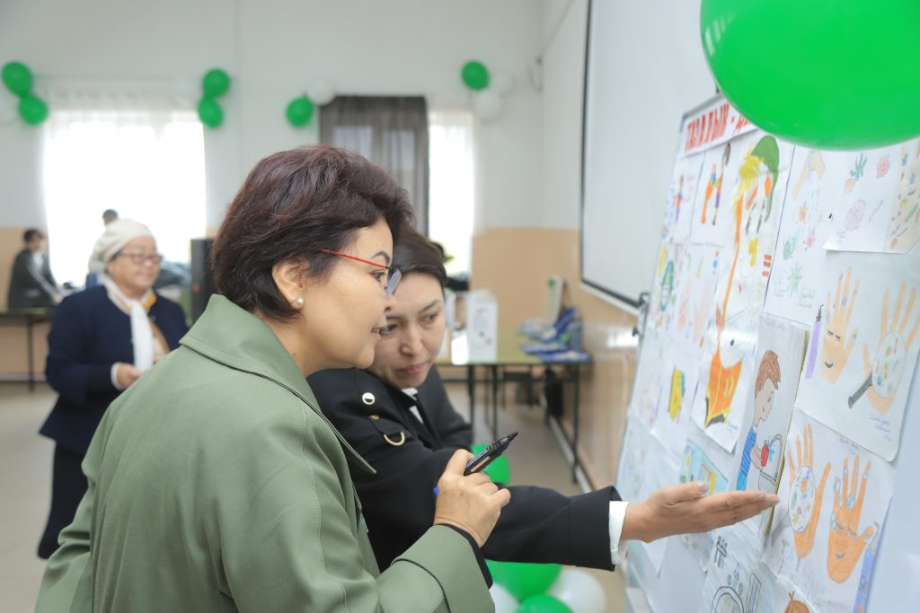
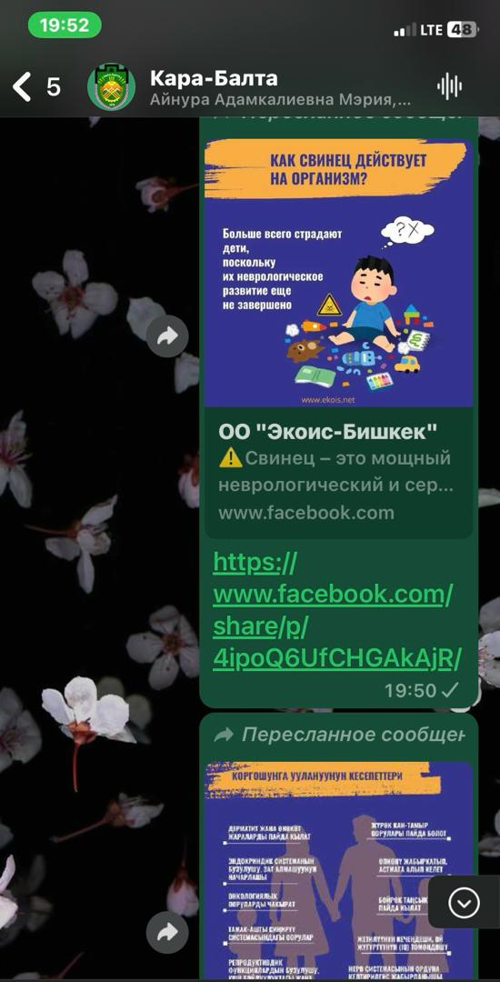
Public Awareness and Outreach
Community meetings in 21 settlements with 113 participants
4 roundtable discussions with district state administration, aiyl okmotu, FMC/PCP management, and school principals
167 seminars with healthcare workers, teachers, and caregivers
117,377 individuals reached through the information campaign in collaboration with the Republican Center for Health Promotion
130,132 healthcare workers, teachers, and caregivers received informational materials via targeted WhatsApp groups
15 media appearances across TV, radio, and online platforms, including regional channel broadcasting to 11 countries with an audience of 170 million
Write your topic
or idea

Slide 10

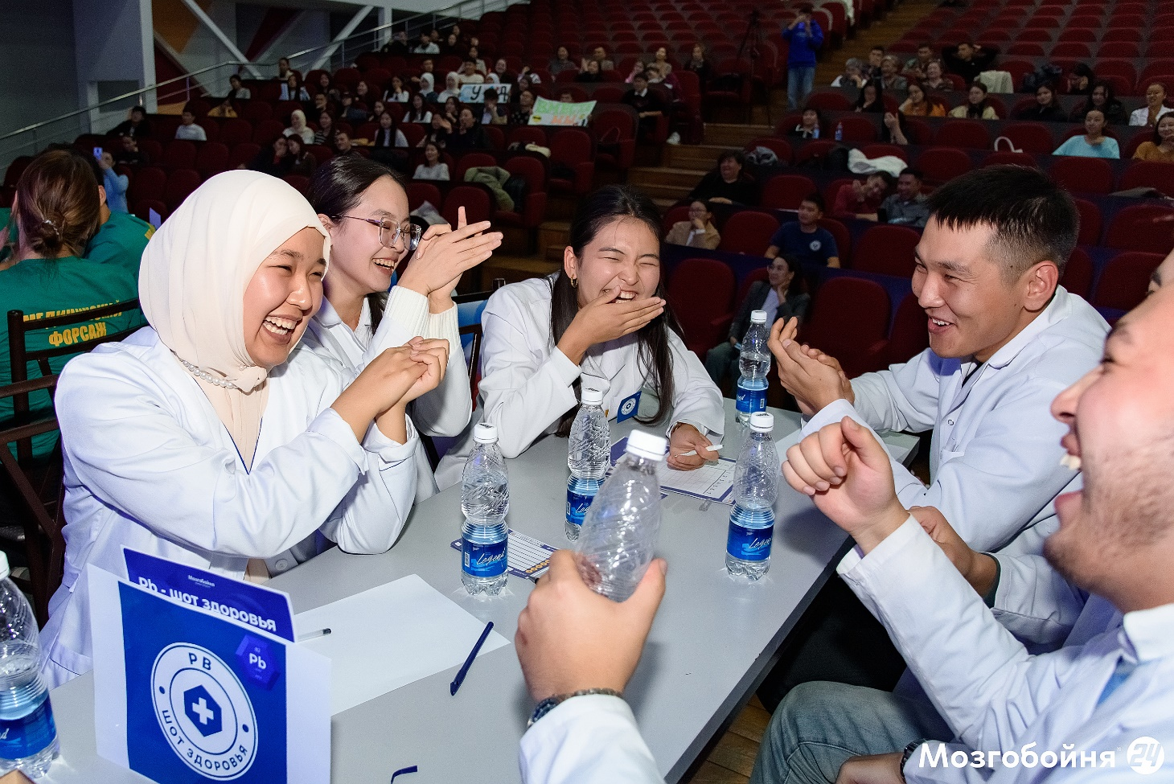

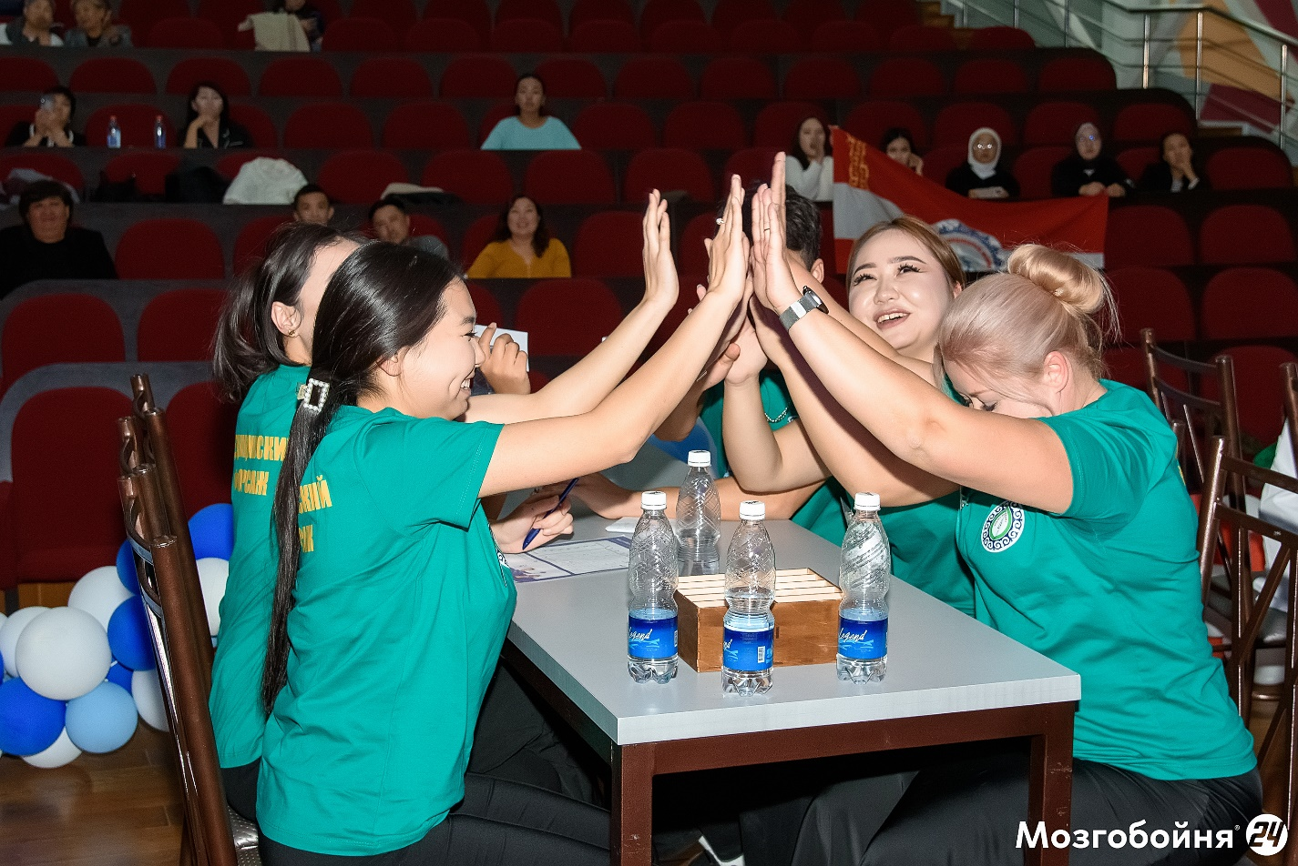
Educational Outreach with Students
2 school events in Bishkek and Kara-Suu called "Lead is Hazardous to Health” reached 268 people.
Interactive Quiz Night organized for students (73 attended)
Educational event with students, teachers, and parents with quizzes, games, and competitions (195 attended)

Slide 11
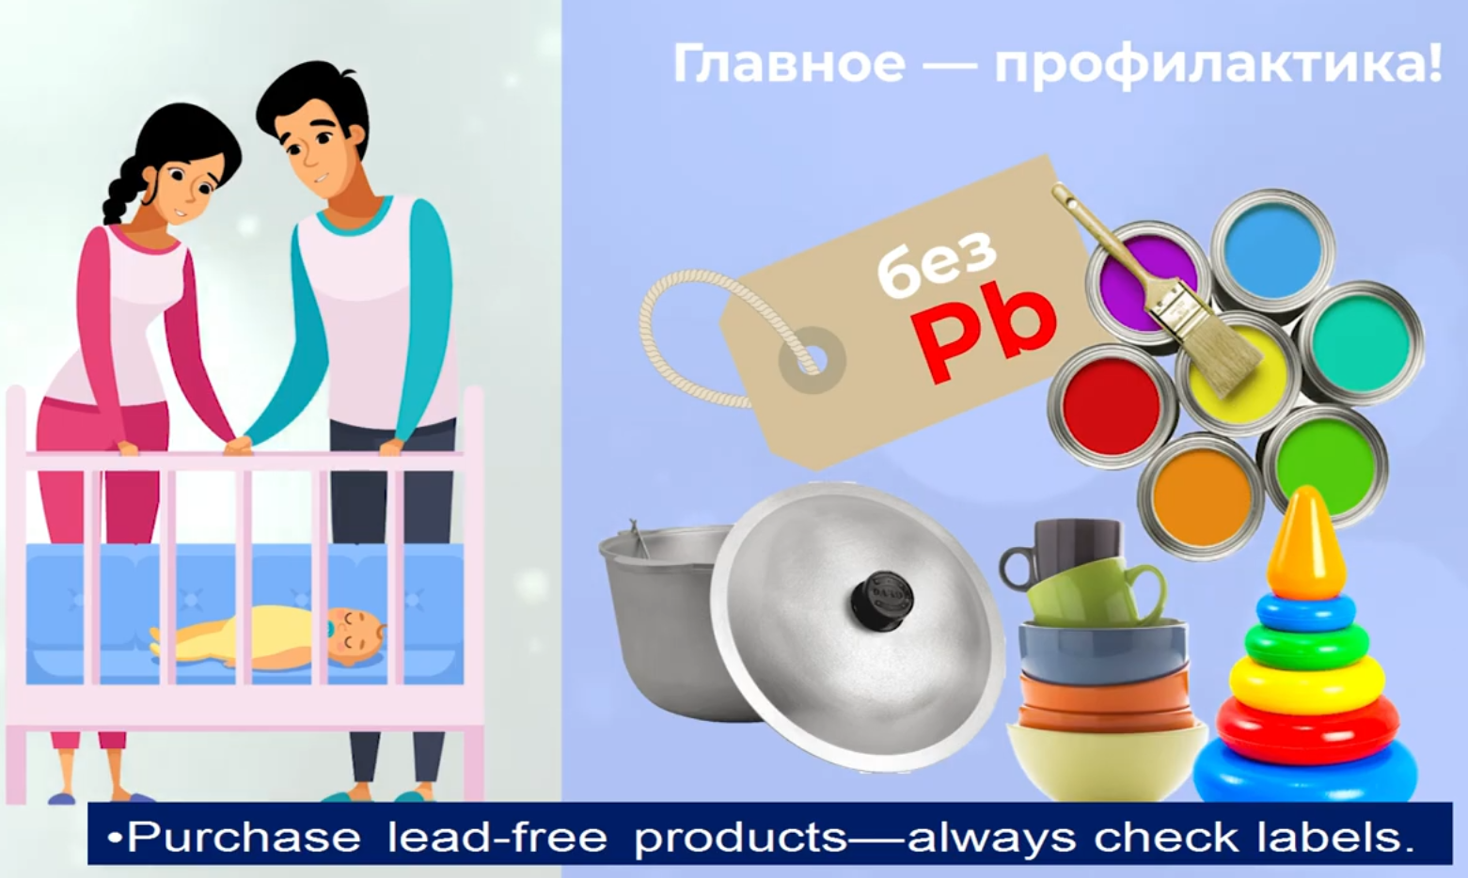
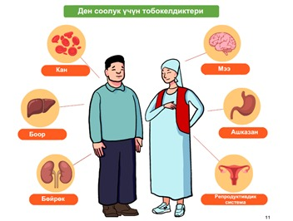

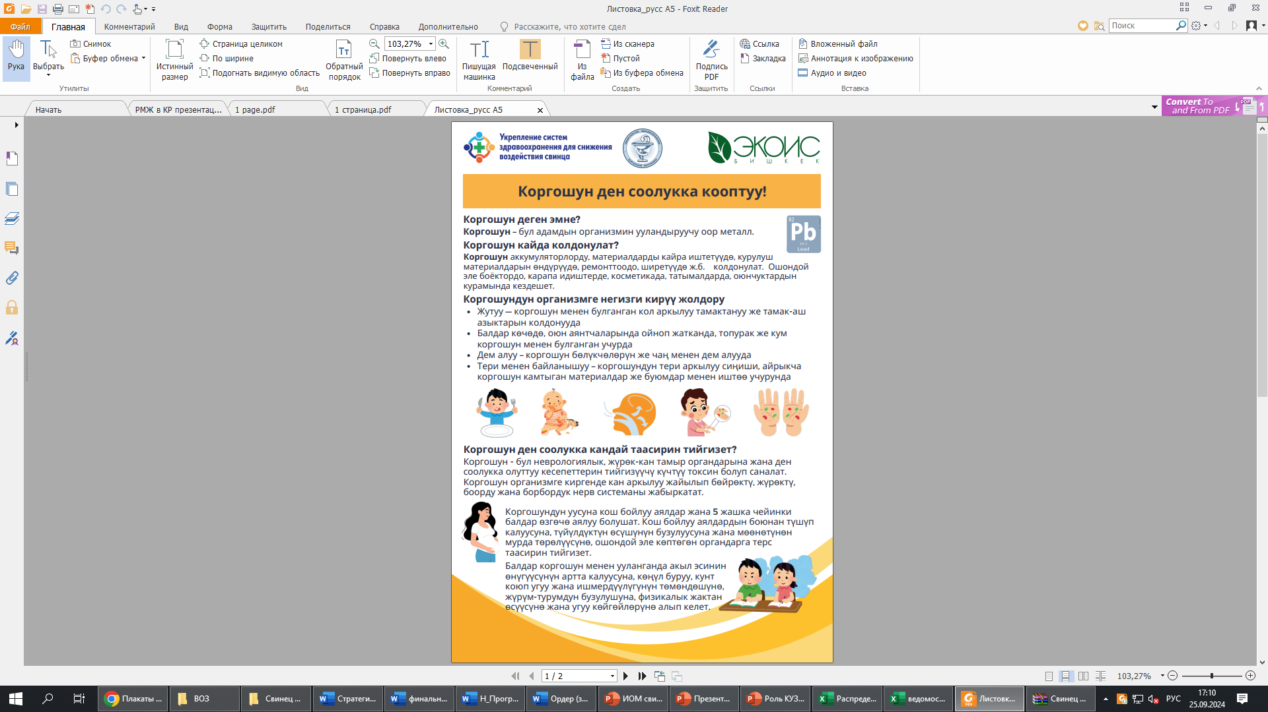

Informational Materials
Informational and educational materials, including public awareness videos, were developed and distributed.

Slide 12
Challenges and Lessons Learned
Future Interventions & Policies to Combat Lead Poisoning
Complicated customs clearance procedures for humanitarian cargo.
No laboratories for determining lead in biological materials (in blood).
No clinical protocols for providing services in cases of lead poisoning.
Refusal by some parents to participate
Active assistance from the Ministry of Health of the Kyrgyz Republic in customs clearance matters.
Collection and transportation of venous blood samples to Moscow, Russia, for analysis at a significant discount by a private laboratory.
An official order from the Ministry of Health to establish a working group for the development of Clinical Guidelines.
Strong interest by the Ministry of Health in obtaining the study results.
We are on the verge of establishing a national monitoring system.

Slide 13
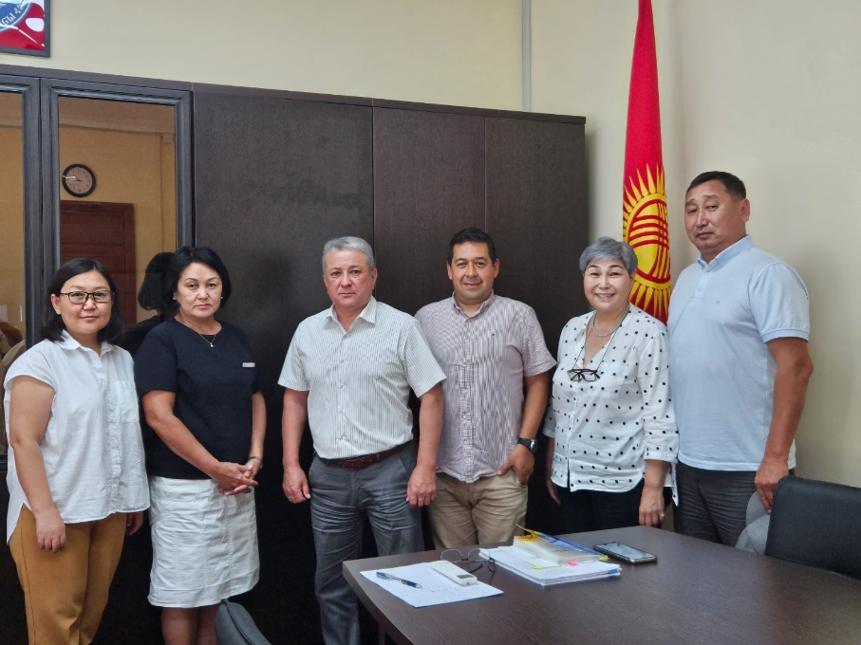
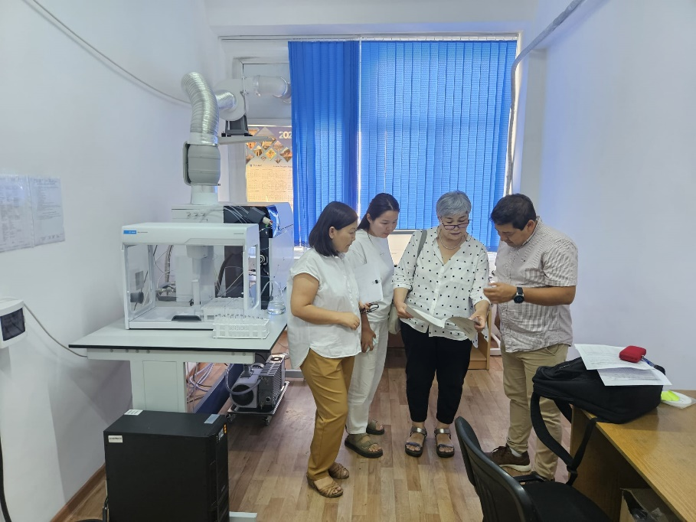
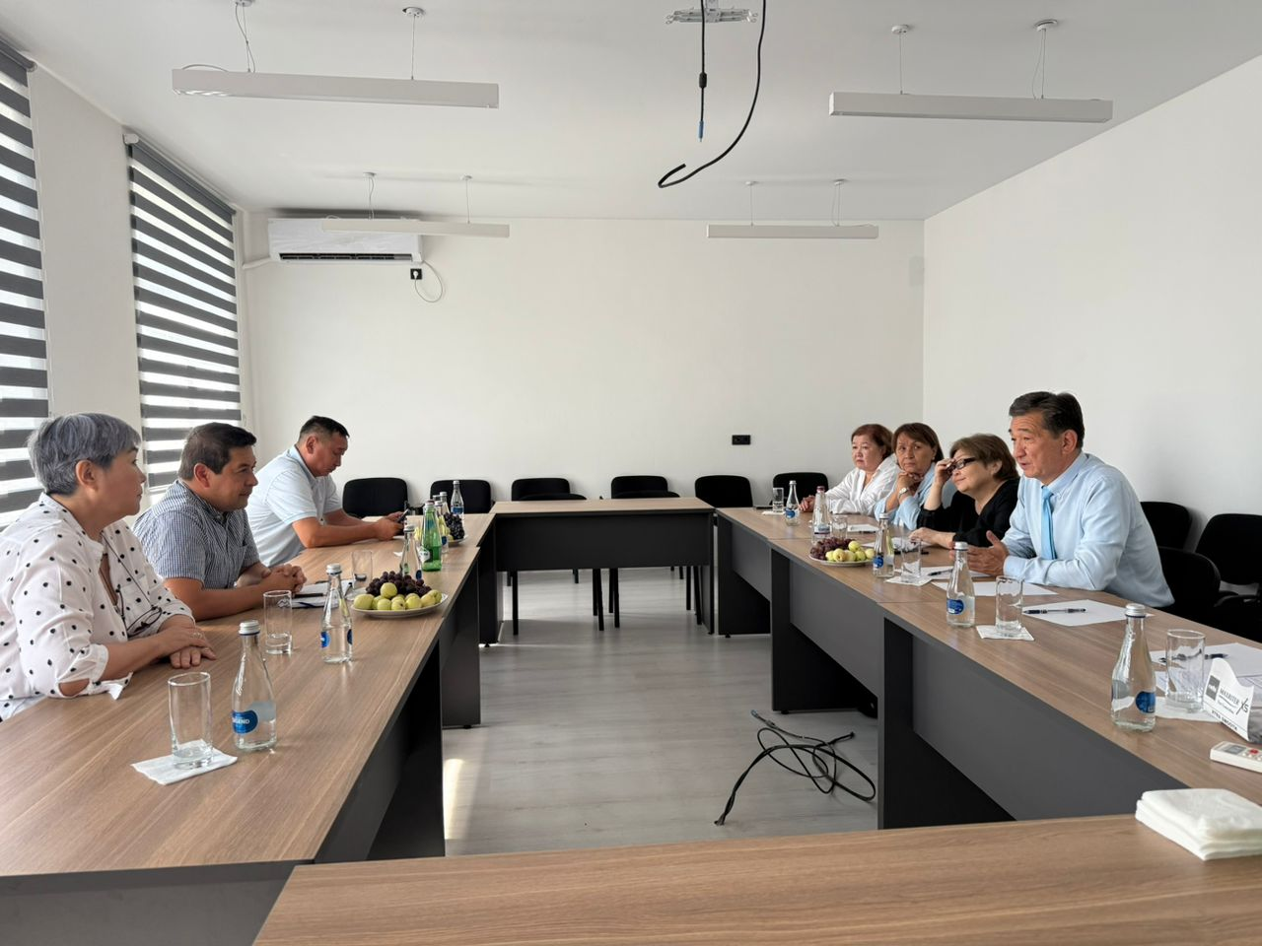
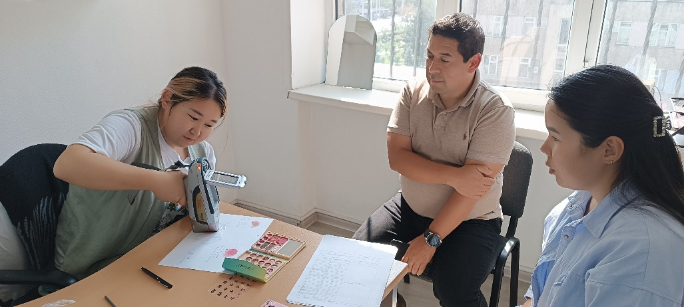
Looking Forward
Procure, install, and commission ICP-MS laboratory equipment
Approve the Clinical Lead Protocol to standardize diagnosis, treatment, and monitoring of lead exposure.
Adapt and implement training modules.
Conduct targeted training sessions for healthcare workers to ensure effective implementation of clinical protocols.
Establish a consultation office/information hub .
Offer consultations for parents of children with elevated lead levels to provide guidance on treatment, prevention, and follow-up care.
Implement comprehensive public awareness campaigns

Slide 14

Thank you for your attention.

